Slide 1
3 Python Fundamentals(2)
Instructor: Raed Karim
Email: raed.karim@sheridancollege.ca
Course: PROG12583

Slide 2
Python Fundamentals(2)
Objectives
At the end of this module, students will be able to:
Prompt users to enter data from keyboard and process them in their programs.
Define and analyze strings.
Define and implement strings functions and methods.
Format program outputs in different data types; int, float and strings.
Apply relational and logical operators.
Define and implement Boolean expressions.

Slide 3
Python Fundamentals(2) Part - 1

Slide 4
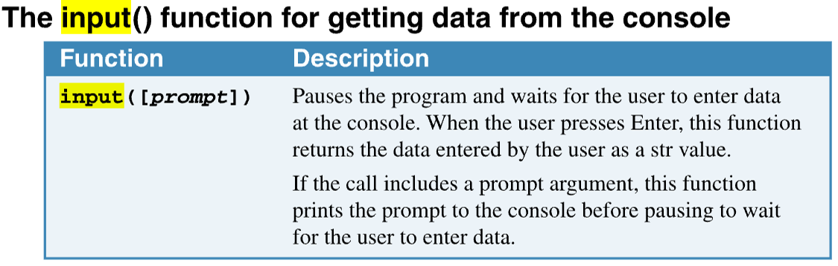
Python Fundamentals(2)
Getting inputs from users
we use Python’s built-in function to read input from the keyboard.
The function reads a piece of data that has been entered at the keyboard and returns that piece of data, as a string, back to the program.
You normally use the function in an assignment statement that follows this general format:

Slide 5
Python Fundamentals(2)
Getting inputs from users
In the general format, prompt is a string that is displayed on the screen.
The string’s purpose is to instruct the user to enter a value.
variable is the name of a that references the data that was entered on the keyboard.
variable = input(prompt)
The input() function always returns string data, even if the user enters a number.

Slide 6
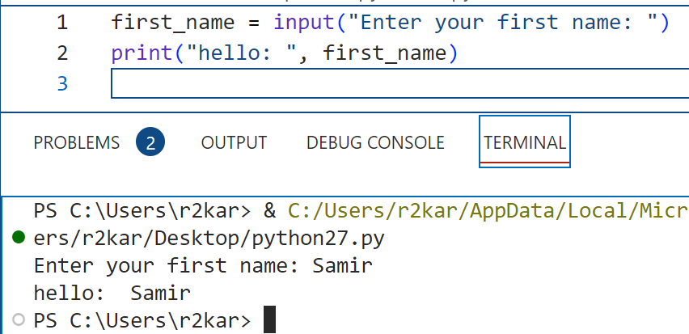
Python Fundamentals(2)
Getting inputs from users
Look at the following example:
When this statement executes, the following things happen:
The string is displayed on the screen.
The program pauses and waits for the user to type the first name on the keyboard and then to press the Enter key.
When the Enter key is pressed, the data that was typed is returned as a string and assigned to the variable, first_name. then print() displays the first name on the screen along with the string “hello : “

Slide 7
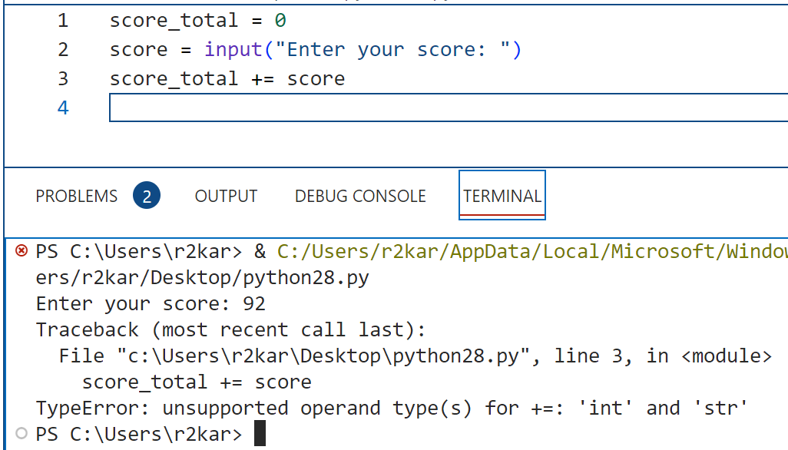
Python Fundamentals(2)
Getting inputs from users
The input() function always returns string data, even if the user enters a number.
if the program tries to add that variable to a variable with a numeric data type, a TypeError exception ( a runtime error) occurs because you can’t add a string to a number.

Slide 8
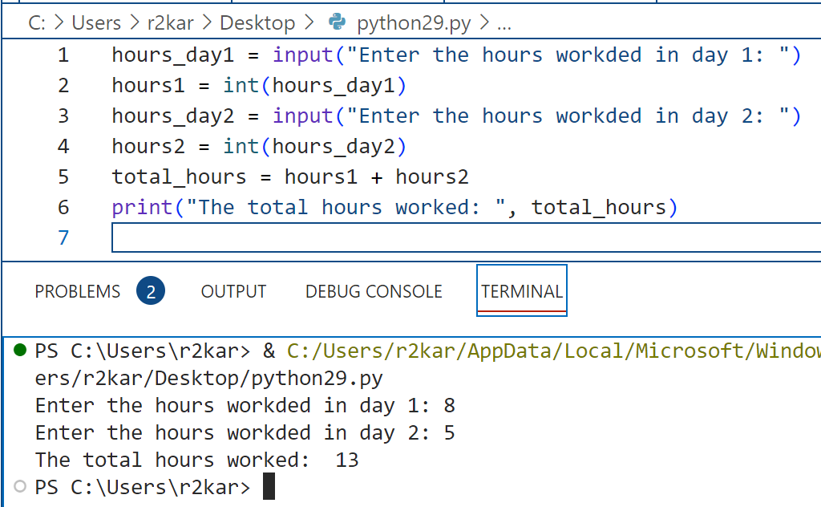
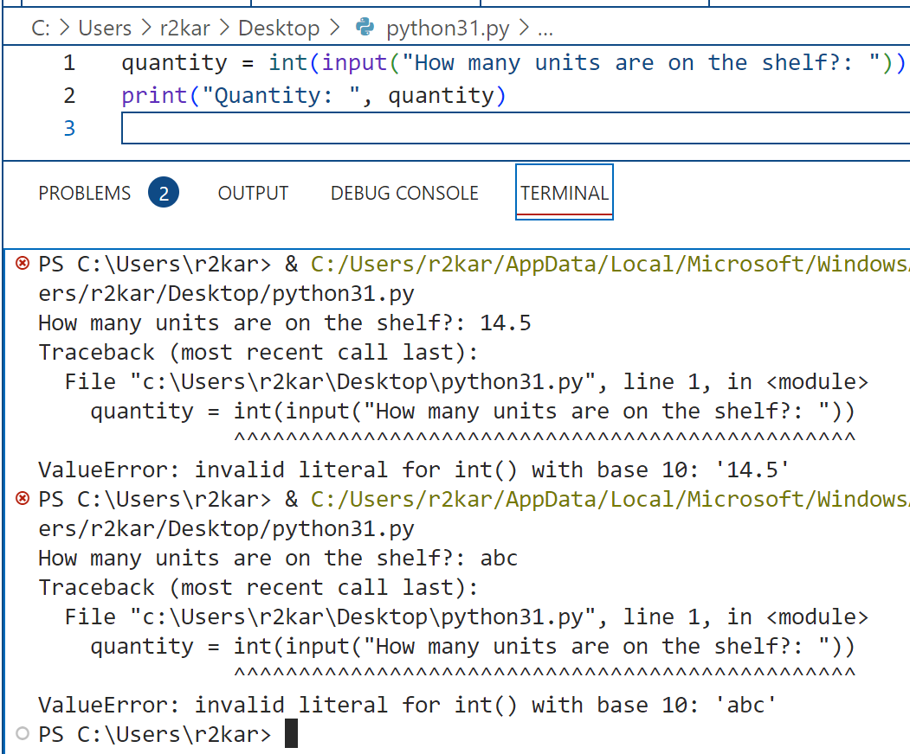
Python Fundamentals(2)
Getting inputs from users
To fix that (the TypeError), you can use the int() and float() functions.
The functions perform type conversions, strings to numerical values that can be used in the arithmetic operations.
Suppose you are writing a payroll program and you want to get the number of hours the two days that the user has worked for, then adding them to get the total hours worked:
* the user inputs must match whatever the conversion functions performs, meaning a user must enter an integer value to be converted to an integer

Slide 9
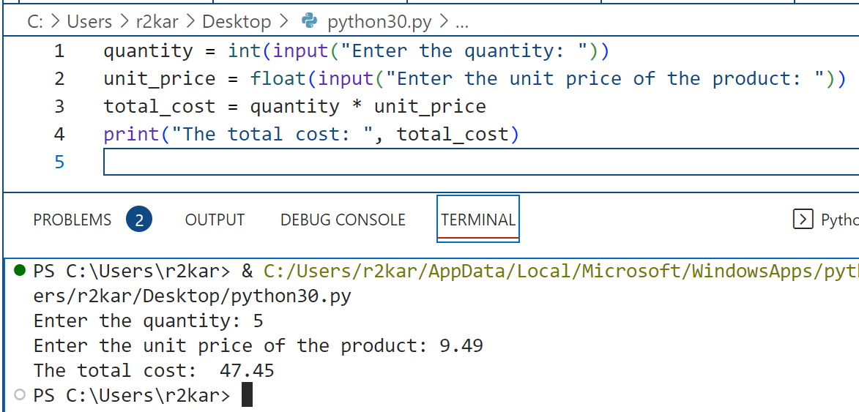
Python Fundamentals(2)
Getting inputs from users
In the previous example, you can chain the functions: input() and int().
The input() function is coded as the argument of the int() function to make one python statement.
In the same way, the input() function is coded as the argument of the float() function.
Suppose, we want to calculate the total cost of 5 products if we know the unit price of a product is $9.49:

Slide 10
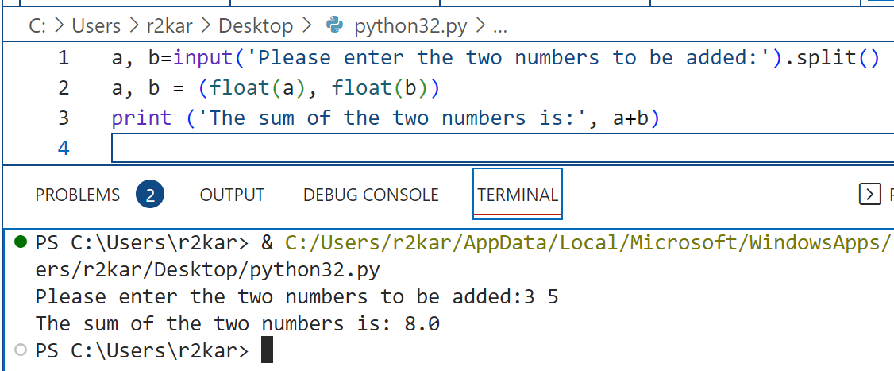
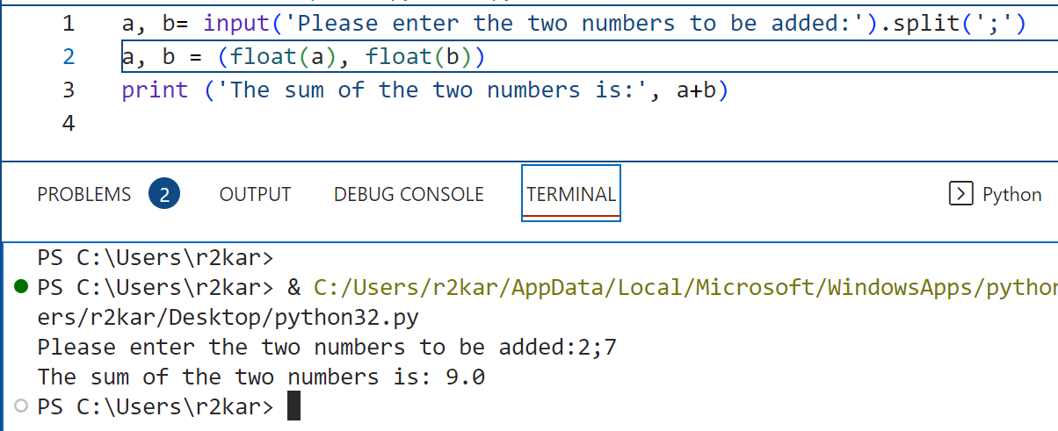
Python Fundamentals(2)
Getting inputs from users
You can prompt the user to enter multiple values in one input statement.
Python has a split() function that must be used so that multiple data is assigned to multiple variables.
Look at the example on right!!
Notice that we left one space between the two inputs: 3 5
You can determine how to separate the inputs at the prompt by adding an argument (a piece of data additional information) inside the parenthesis, such a special character from the keyboard; e.g., ( ,), (;), (:), (|), etc.
Notice how we use the float() function to convert the two inputs in line 2 of the program !

Slide 11
Python Fundamentals(2)
Getting inputs from users: Do it yourself !
Prompt the user to enter the value of miles driven by her vehicle.
Prompt her again to enter the value of gallons consumed by the vehicle.
Calculate the value of mpg (mile / gallons).
Print the value of mpg.

Slide 12
Python Fundamentals(2) Part - 2

Slide 13
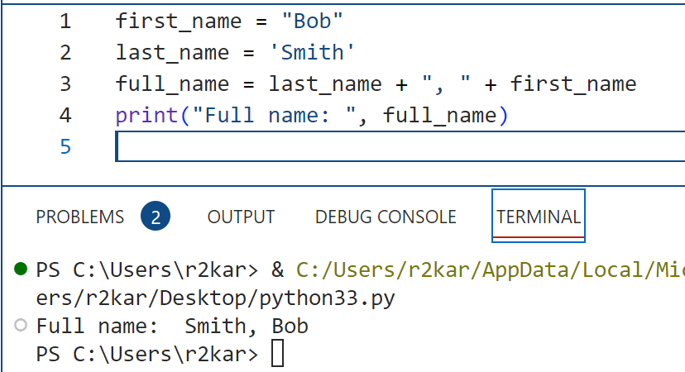
Python Fundamentals(2)
Working with string data
In the last week lesson, we learn a few things about string data types in python such as quotations, assigning strings to variables, printing string data and using str() function.
In this week, we can dig a little deeper into this amazing type of data: string !
You can concatenate strings into a single unified string. Concatenation means joining two or more string to form a single one, like joining your first name then a space then your last name to form your full name. The + operator is used to concatenate. Note the + is also the addition operator to add numbers, as we have learned last week.

Slide 14
Python Fundamentals(2)
Working with string data
Data in Python are objects, including strings. Objects are associated with methods. In a particular str object a method called format.
The syntax for methods is as follows: object.methodname(parameters)
* parameters are pieces of data passed to methods to process it

Slide 15
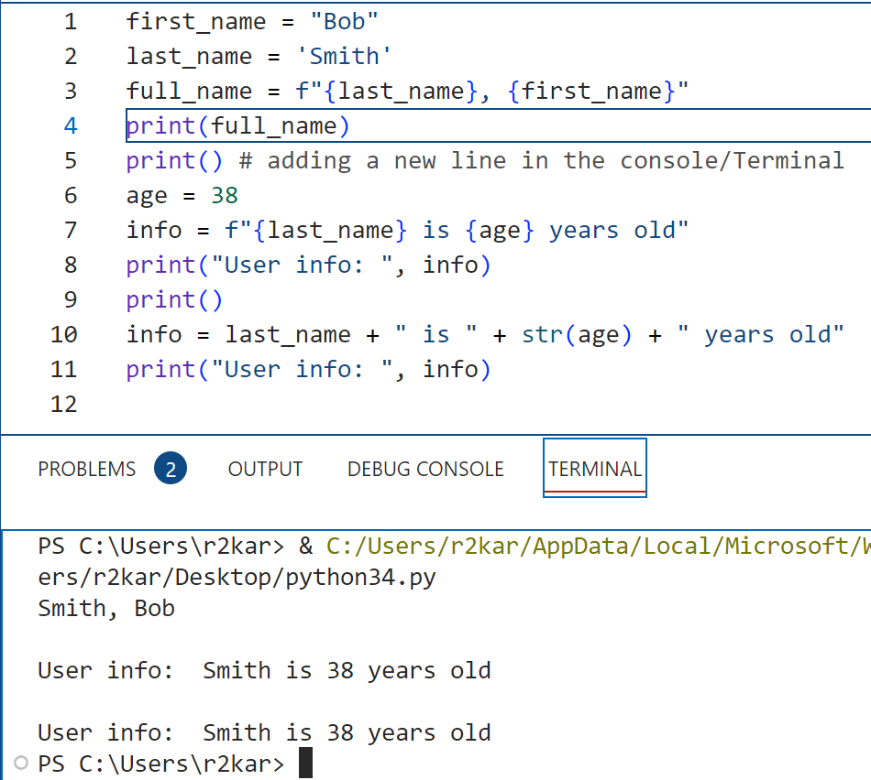
Python Fundamentals(2)
Working with string data
You can also join strings with f-string.
You can join strings with numbers into a single string.
* Notice in line 10 of the code, we use str() to convert the numerical value of age into a string to concatenate it with
other string data in the statement.
Try to remove str() from line 10 and run the program again, What do you observe ? why?!!

Slide 16
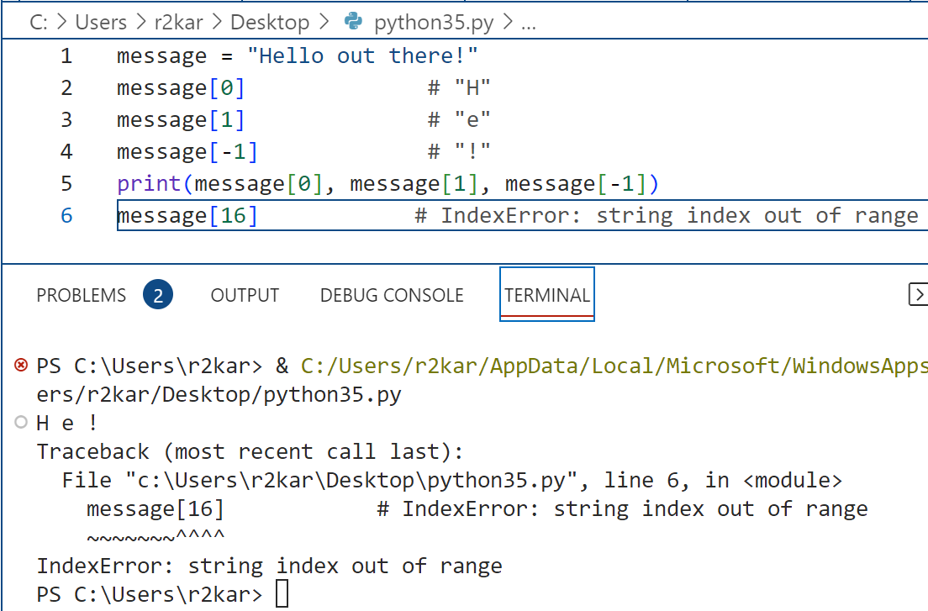
Python Fundamentals(2)
Working with string data
You can access a character in a string using indexes.
Each character in a string has an index that can be zero, a positive or negative integer. It specifies the position of the character in the string. From the left side of the string, indexes start from zero, and from the right starts with -1.

Slide 17
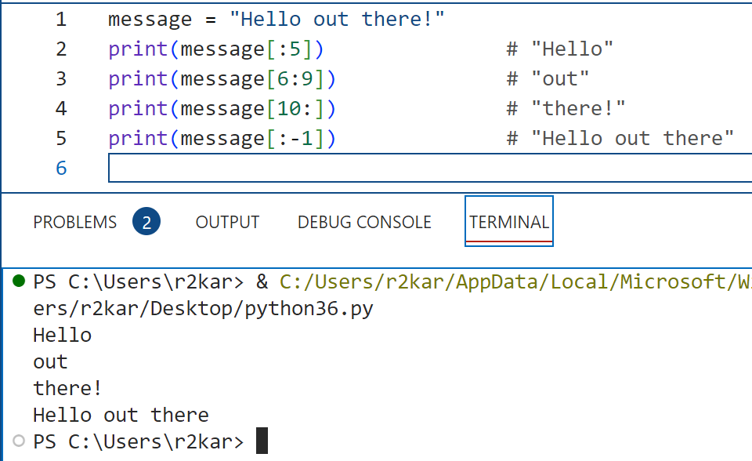
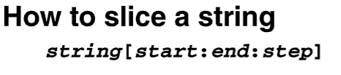
Python Fundamentals(2)
Working with string data
You can slice a string meaning you get a span of characters from within the string. Sometimes slices are called substrings.
How to slice a string:
* Python slices a string starting from the index at start to the index at end - 1

Slide 18
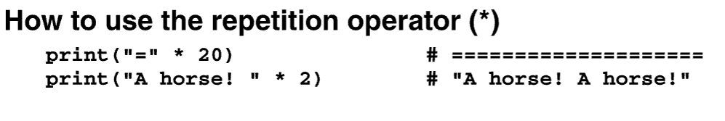
Python Fundamentals(2)
Working with string data
You can use the repetition operator to repeat a string.

Slide 19
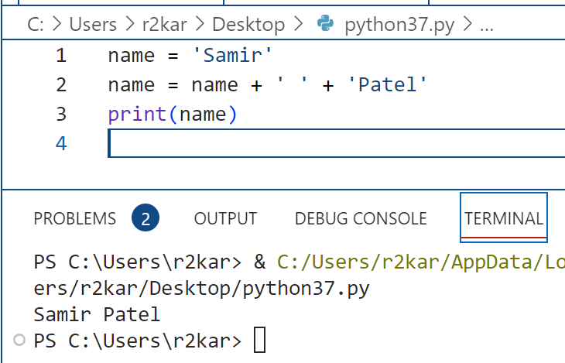
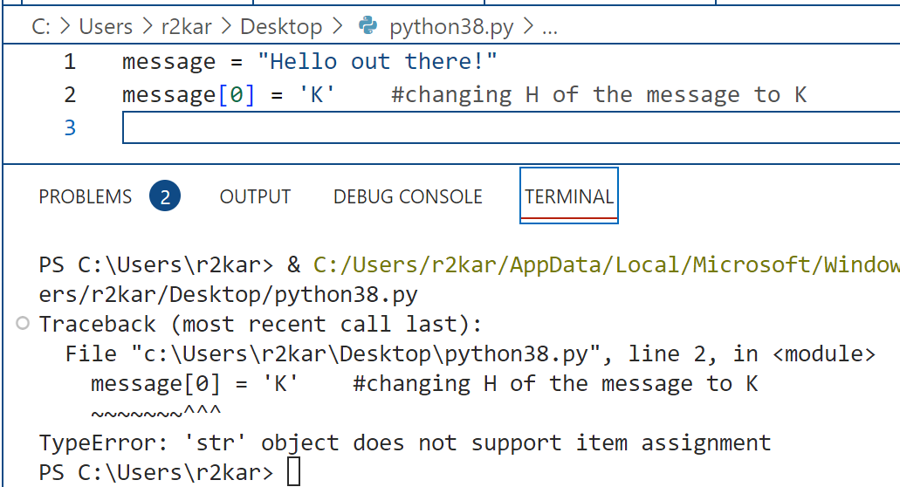
Python Fundamentals(2)
Working with string data
Strings are immutable meaning that means once they are created, they cannot be changed or modified.
Some operations, such as concatenation or slicing, give the impression that they modify strings, but in reality they do not.
In the first example, we do not change the string name rather we concatenate it with two new strings, a single space and ‘Patel’ to create a new string of name (line2).
In the second example, we try to change the first character of the string referred to with the variable name.
Since strings are immutable, python threw an exception.

Slide 20
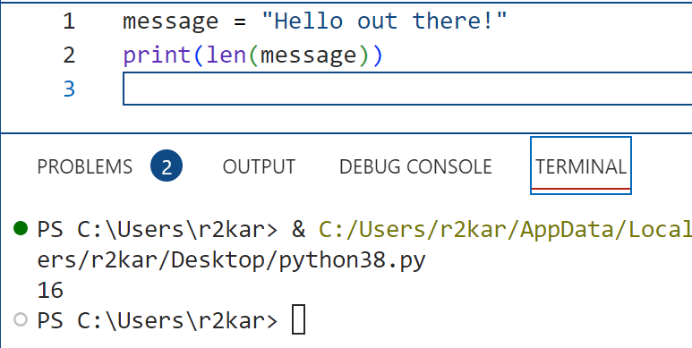
Python Fundamentals(2)
Working with string data
Python has a built-in function (len) that returns the length of a string (the number of characters contained in the string .
string length: len(string)
* Len function can also be used for the other sequences in python as we will learned about in future.

Slide 21
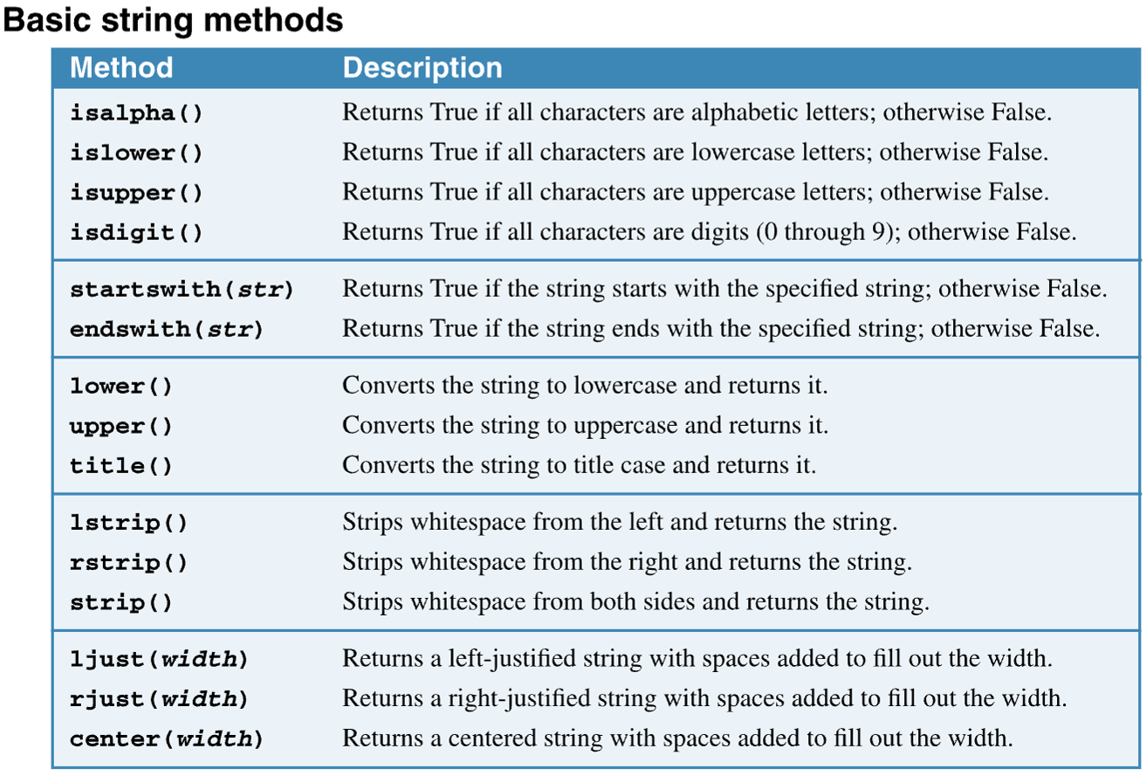
Python Fundamentals(2)
Working with string data
Python offers a set of built-in methods that can used to work with strings. Built-in methods are programs have been developed and are ready to use by programmers. They are loaded to your computer when you installed python interpreters.
The two first groups in the table, methods return either True or False value after they have been processed by the interpreter.
* The Python Boolean type is one of Python's built-in data types. It's used to represent the truth value of an expression. For example, the expression 1 <= 2 is True , while the expression 0 == 1 is False . Understanding how Python Boolean values behave is important to programming.

Slide 22
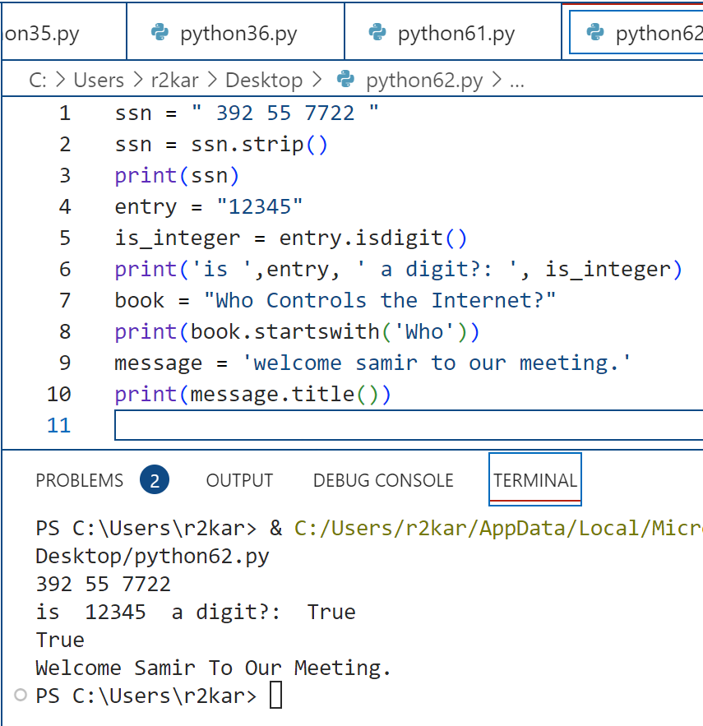
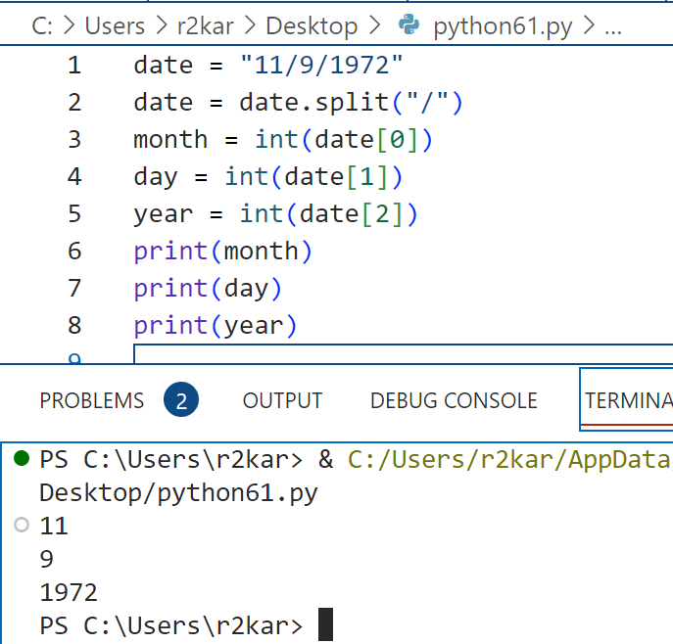
Python Fundamentals(2)
Working with string data: examples

Slide 23
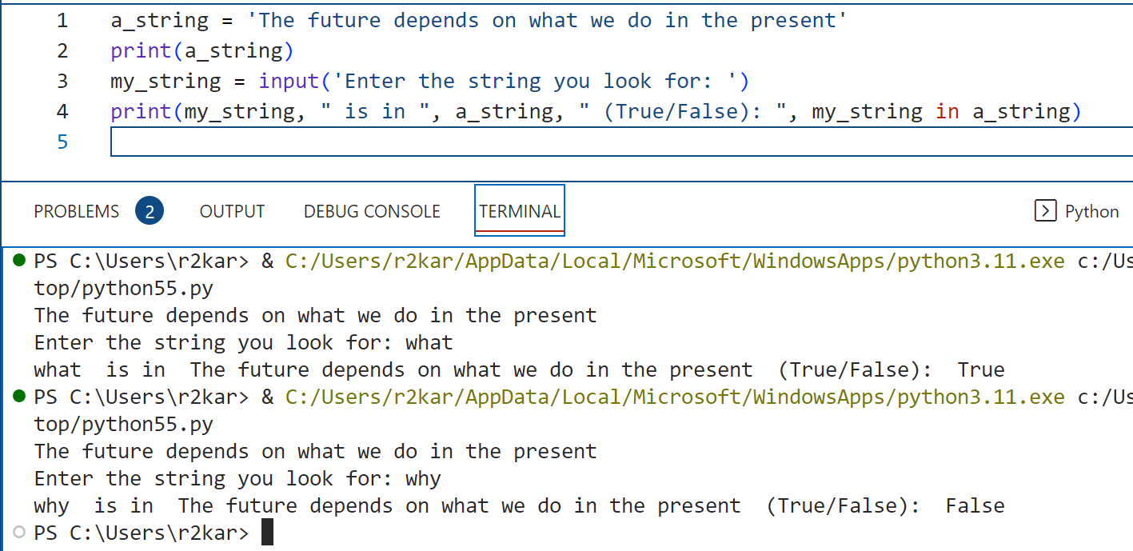
Python Fundamentals(2)
Working with string data: testing a string with in and not in
In Python, you can use the operators ( in ) or ( not in ) to determine whether one string is contained in another string. The syntax is: string1 in string2
The expression returns true if string1 is found in strings; otherwise, it returns false.
You can also use the operator to determine whether one string is not contained in another string.
string1 not in string2

Slide 24
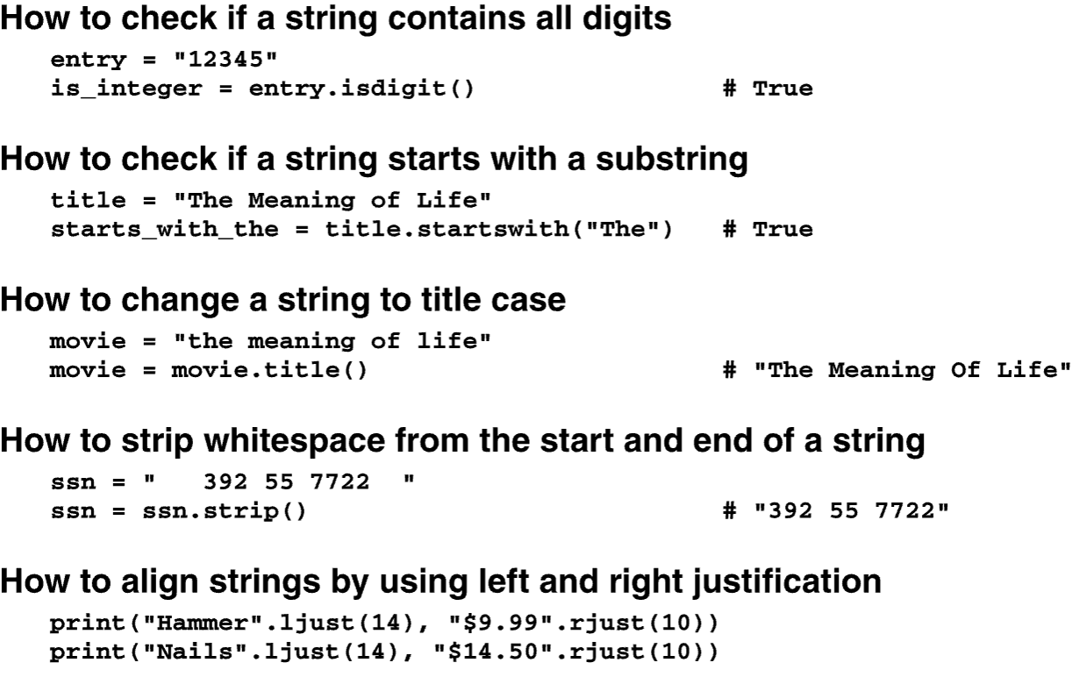
Python Fundamentals(2)
Working with string data: Do it yourself!
Look at the code shown on the right side to implement string methods: your task is to add a print statement after each block of statements to display its output

Slide 25
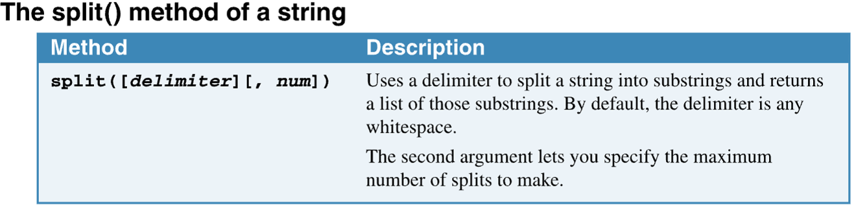
Python Fundamentals(2)
Working with string data
You can use the split() method to split a string into a list of strings.

Slide 26
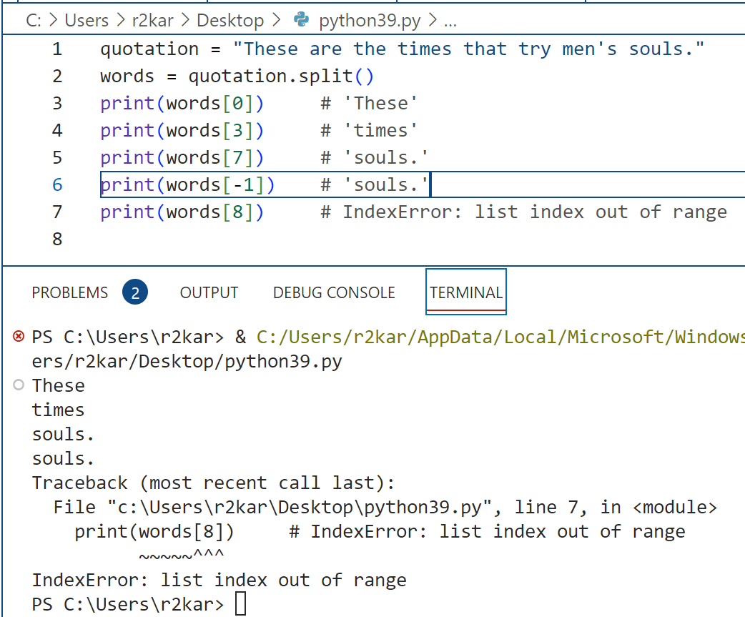
Python Fundamentals(2)
Working with string data
In the code shown on the right, the string quotation is split into a set of words with the space delimiter, since no parameter is supplied in the split() method.
* A delimiter is a character that’s used to divide a string into multiple parts.

Slide 27
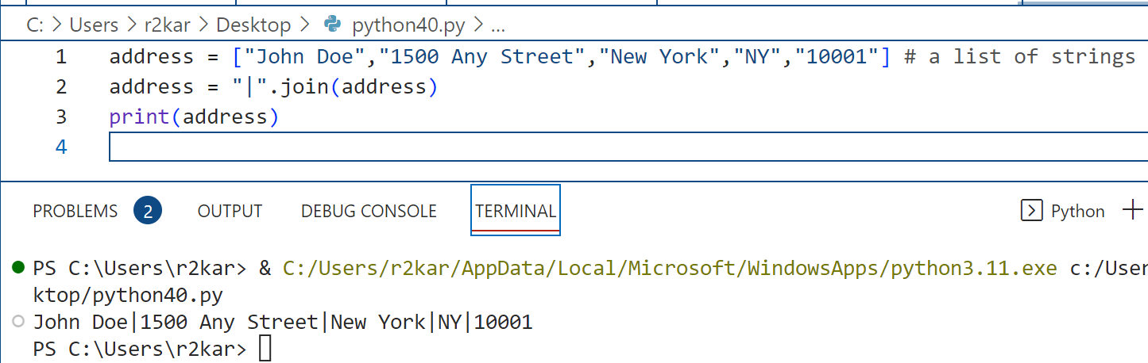
Python Fundamentals(2)
Working with string data
You can use the join() method to join a list of strings into a single string.
In the example, the second statement specifies the pipe character (|) as the delimiter for the strings in the list. As a result, the joined string consists of each item in the list separated by the pipe character.

Slide 28
Python Fundamentals(2)
Working with string data: Do it yourself?
A variable, word, hold a string value of ‘Sheridan’, use the string method, join to produce the following output: S h e r i d a n

Slide 29
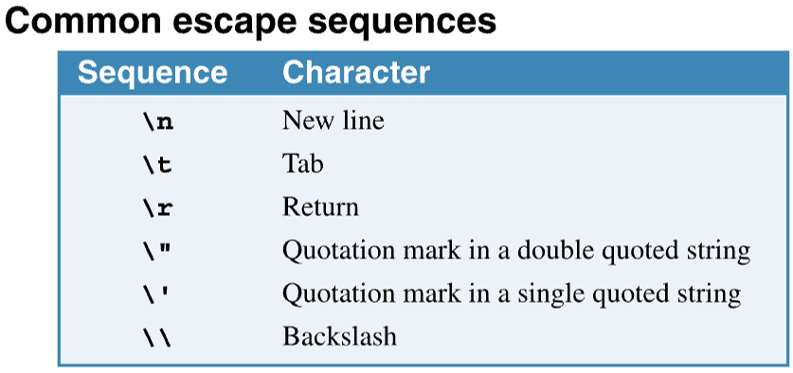
Python Fundamentals(2)
Working with string data: escape sequences
Escape sequences to include special characters
These sequences let you put characters in a string that you can’t put in just by pressing the appropriate key on the keyboard. For instance, the \n escape sequence is similar to pressing the Enter key in the middle of a string.
On the right side, a table that shows how to use escape sequences.

Slide 30
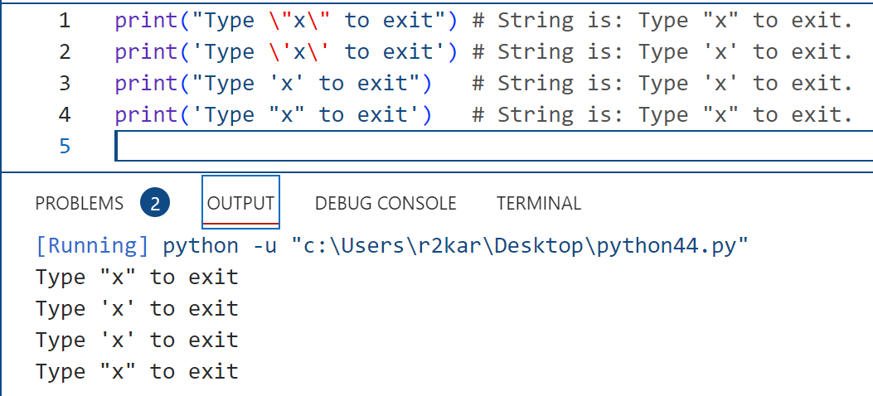
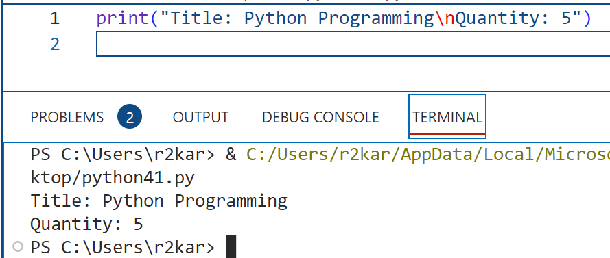
Python Fundamentals(2)
Working with string data: escape sequences
Escape sequences are needed so the Python compiler can interpret the code correctly. For instance, since single and double quotations marks are used to identify strings, coding them within the strings can cause syntax errors. But when the quotation marks are preceded by escape characters, the Python compiler can interpret them correctly. Escape sequences to include special characters
In the example, four ways to include quotation marks in a string
In the example, the new line sequence is used to start a new line.

Slide 31
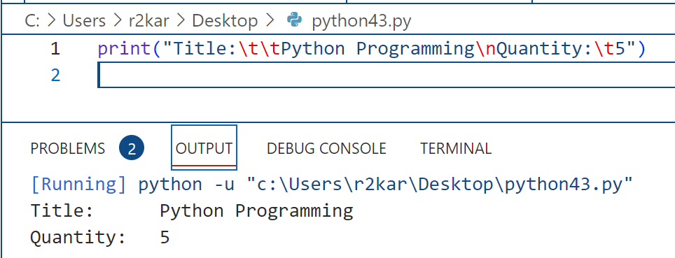
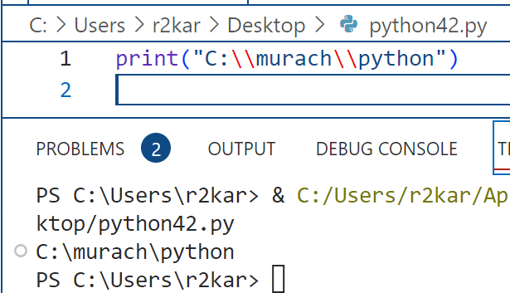
Python Fundamentals(2)
Working with string data: escape sequences
Escape sequences are needed so the Python compiler can interpret the code correctly. For instance, since single and double quotations marks are used to identify strings, coding them within the strings can cause syntax errors. But when the quotation marks are preceded by escape characters, the Python compiler can interpret them correctly. Escape sequences to include special characters
In the example, adding a tab within a string.
In the example, the backslash sequence is used to display a backslash character.

Slide 32
Python Fundamentals(2)
Working with string data: : using format method()
There is a particular operation on strings called format, that makes substitutions into places enclosed in braces.
There could be multiple replacements in the format approach as shown in the example below.
Each place in the format string where there is '{}', the format operation will replace the value of the next
parameter in the format parameter list.

Slide 33
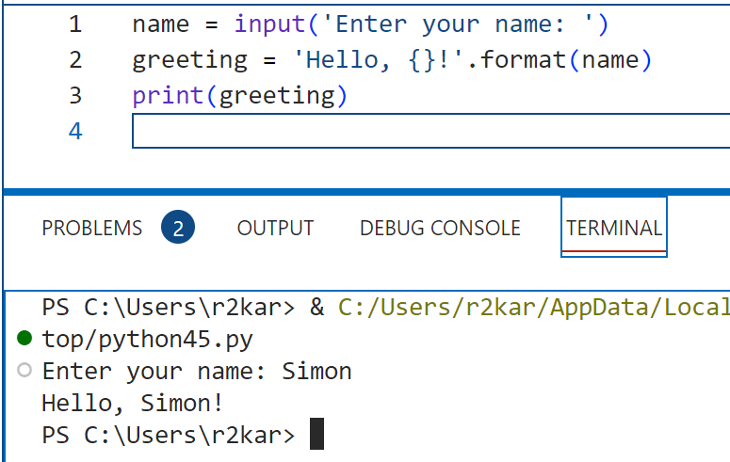
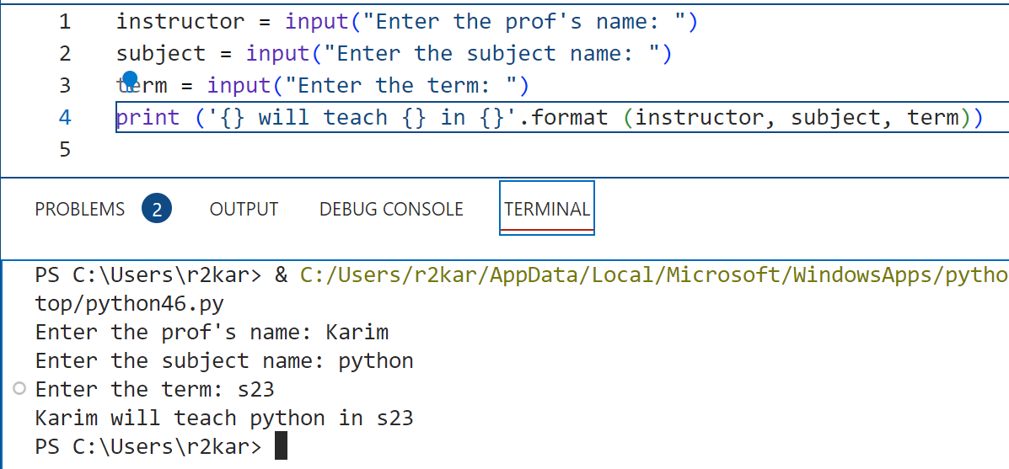
Python Fundamentals(2)
Working with string data: using format method()
In the first example, python replaces {} with the value of the format parameter, name. here the value of variable name is taken from the user (line 1).
In the second example, the object contains three places. format(instructor, subject, term) replaces the places with the three parameters: instructor, subject, term. Their values are entered by the user (lines 1,2 and 3)

Slide 34
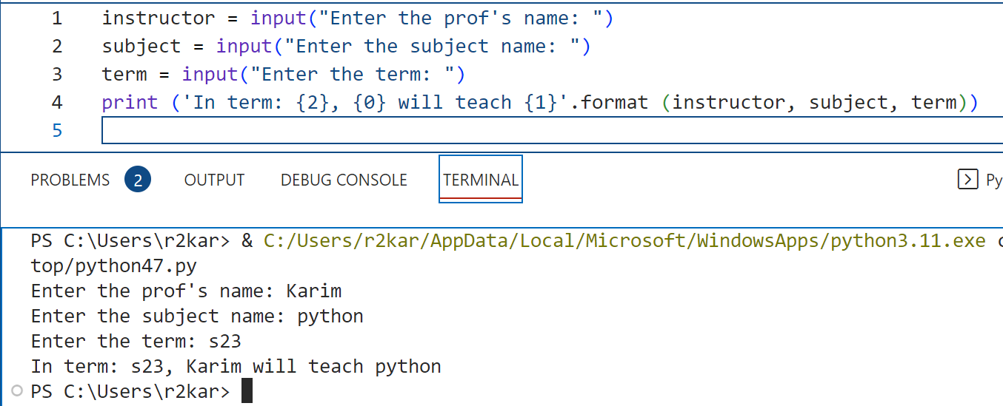
Python Fundamentals(2)
Working with string data: using format method()
With the format () method, you can number the places. You can choose any order of numbers, like: {2},{0},{1}.

Slide 35
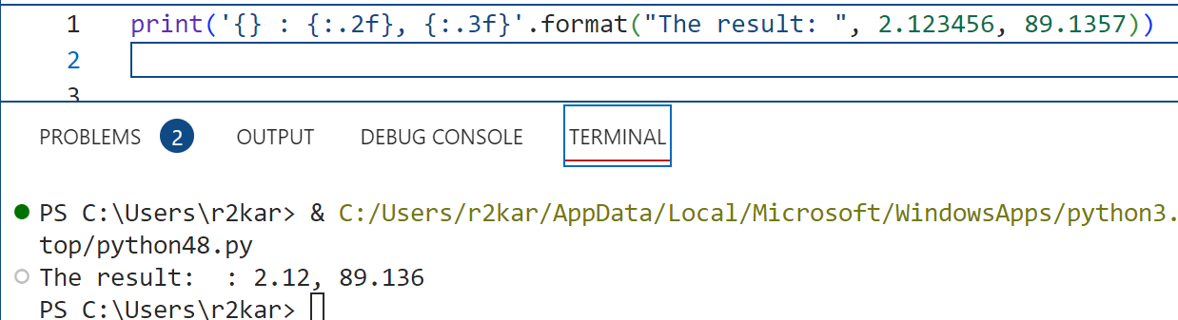
Python Fundamentals(2)
Working with string data: using format method()
With the format () method, you can format float numbers by providing additional information with { }.
You can specify how many decimal digits to format a number, the syntax:
{m.nf}.format(x)
m: the order of the value to place , n: the number of digits to format , f: indicates the number is float type
In the example, the first value is a literal string, the second is a float value with 2 digits after the decimal point, the last value is another float with 3 digits after the decimal point. Note that you can specify the order of places by entering them within { } and before :

Slide 36
Python Fundamentals(2)
Working with string data: Do it yourself!
Write a python program to display the output as shown in the sample below. Use string methods and format method. There is a tab in each of the third and fourth lines. Using format() round the amount in dollar to 3 digits.
J Z C O R P
Business Account
a link to the file: C:\users\jzcorp\ba.txt
amount in dollar: 456.45912

Slide 37
Python Fundamentals(2)
Working with string data: formatting strings
In python you can also format your string with % operator. You can print characters at some specific locations on the line that has tabular format.
To specify the print format you need to use a specific field width (field width specifiers). Field width is the total number of spaces a string must use, including any spaces. The syntax to format a string:
(“%Ns” % “string-to-format”)
N is the number of spaces a string must use; s indicates the type of data is string.
If N is positive then is Right-Justified, negative is Left-Justified.

Slide 38
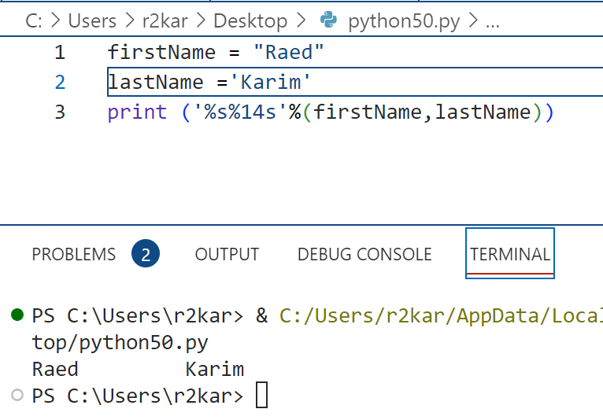
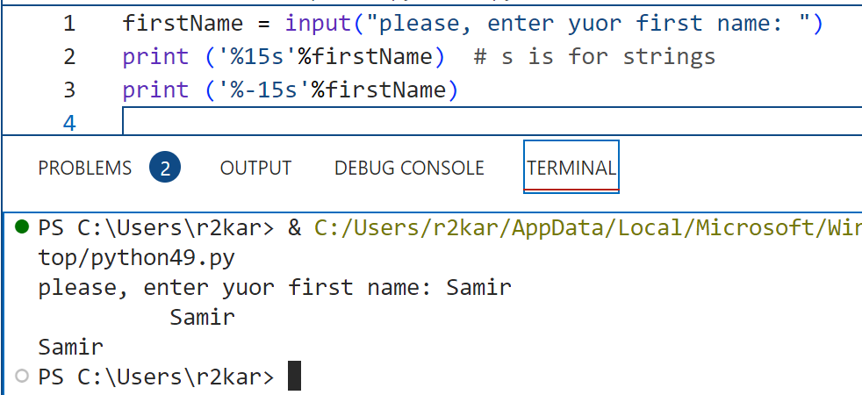
Python Fundamentals(2)
Working with string data: formatting strings (more examples)
in the example, the first name is right justified (line 2) and last name is left justified by 14 spaces both in the same print() line.
in the example, the first name is right justified by 15 spaces (line 2), and left justified by 15 spaces (line3).

Slide 39
Python Fundamentals(2)
Working with string data: formatting integer and float numbers
To format integers you use the same syntax, as in strings, but instead of s you use d, which specifies integer data type.
(“%Nd” % number)
If you have to tabulate multiple numbers, you can use multiple format operators
(“%Nd%Nd%Nd” % (num1, num2, num3))
In cases like this the first %N applies to num1, the second to num2, and so on.

Slide 40
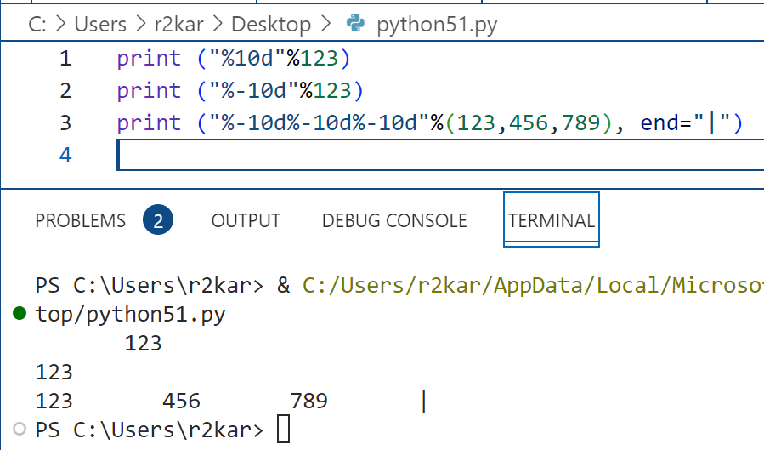
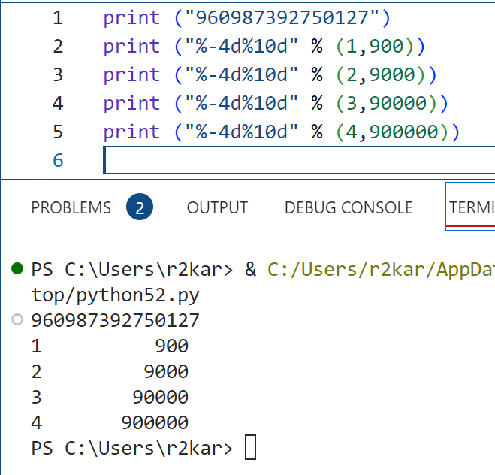
Python Fundamentals(2)
Working with string data: formatting integer and float numbers (examples)

Slide 41
Python Fundamentals(2)
Working with string data: formatting integer and float numbers
We have seen how to format a floating point number, such as the format() function, format method, and round() function. You also can format using ( % ) operator following the syntax:
(‘%n.mf’%(float numbers)
n is the number of spaces to use, and m the decimal digits, f floating point data type.
To left justify use a negative n.

Slide 42
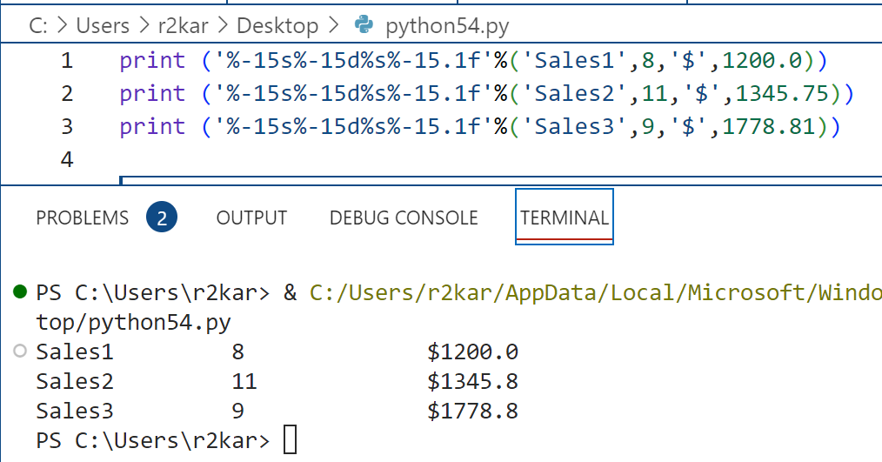
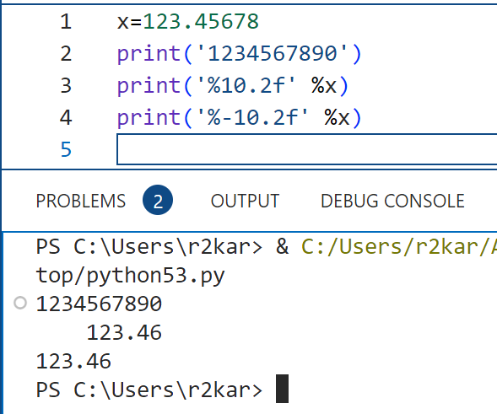
Python Fundamentals(2)
Working with string data: formatting integer and float numbers (examples)

Slide 43
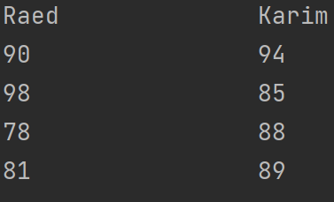
Python Fundamentals(2)
Working with string data: Do it yourself!
1. Personal Information
Write a program that displays the following information:
Your name
Your address, with city, state, and ZIP
Your telephone number
Your college major
2. Sales Prediction
A company has determined that its annual profit is typically 23 percent of total sales. Write a program that asks the user to enter the projected amount of total sales, then displays the profit that will be made from that amount.
3. Land Calculation
One acre of land is equivalent to 43,560 square feet. Write a program that asks the user to enter the total square feet in a tract of land and calculates the number of acres in the tract. Hint: Divide the amount entered by 43,560 to get the number of acres. 4. Write a python program that create the output as shown in the screenshot (make sure to format the data as you learned in this lesson:

Slide 44
Python Fundamentals(2) Part - 3

Slide 45
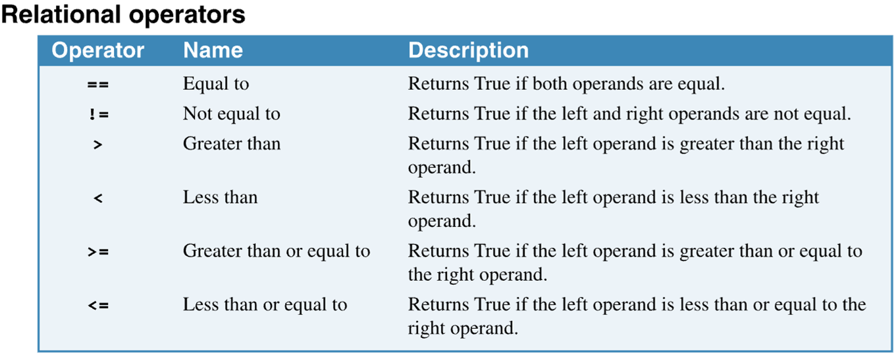
Python Fundamentals(2)
Working with relational and logical operators
Boolean expressions (or conditional expressions) are logical statements (in a programming language) that can be used to test the relationships between two or more values if a specific relationship is True or False (e.g., user_name == ‘r2kar’). Here, we test if user name is equal to ‘r2kar’, if it is, the result is True; otherwise, False.
The Boolean expressions use six relational operators as summarized in the table shown below:
* Boolean expressions, named in honor of the English mathematician George Boole. In the 1800s, Boole invented a system of mathematics in which the abstract concepts of true and false can be used in computations.

Slide 46
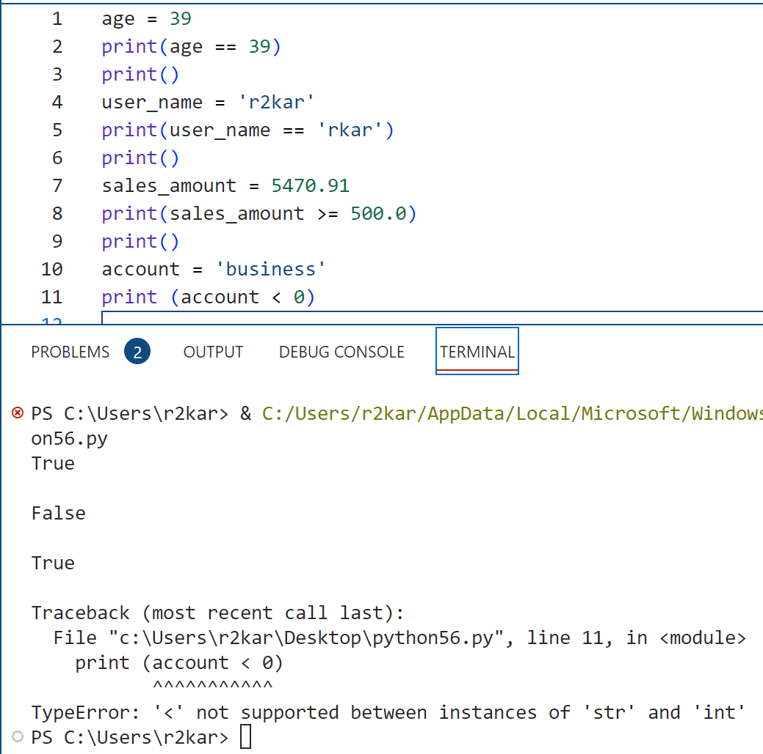
Python Fundamentals(2)
Working with relational and logical operators
In the example, (lines 1-2), we compare the value of age with 39 if they are equal; both are integers. In lines(4-5), we compare the value of user_name with the value of ‘r2kar’ if they are equal; both are literal strings. The same is in lines(7-8), but the values we compare are float numbers.
In lines(10-11), we compare a string with a number which causes a runtime error. You need to make sure that your expressions compare numbers with numbers and strings with strings.

Slide 47
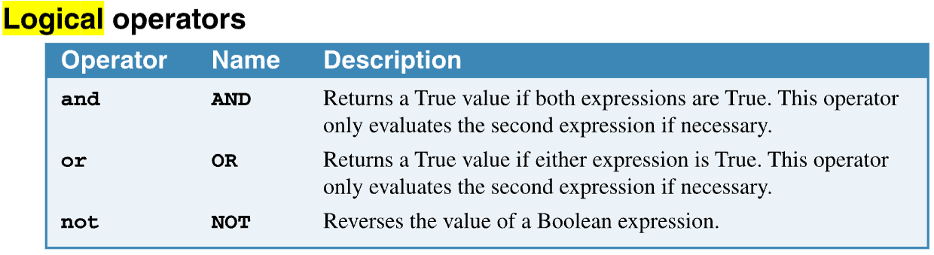
Python Fundamentals(2)
Working with relational and logical operators
To code a compound conditional expression, you can use the logical operators as shown in the table below:
If you use the AND operator, the compound expression only returns True if both expressions are True. If you use the OR operator, the compound expression returns True if either expression is True. If you use the NOT operator, the value returned by the expression is reversed (True to False and vice versa).

Slide 48
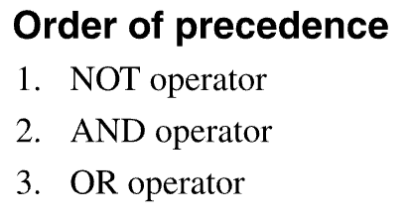
Python Fundamentals(2)
Working with relational and logical operators
The logical operator also have the order of precedence as shown below:
That is the order in which the operators are evaluated if more than one logical operator is used in a compound expression. This means that NOT operators are evaluated before AND operators, which are evaluated before OR operators. Although this is normally what you want, you can override this order by using parentheses.

Slide 49
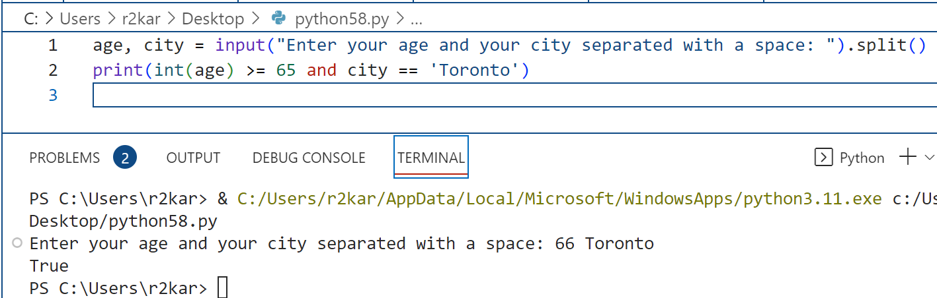
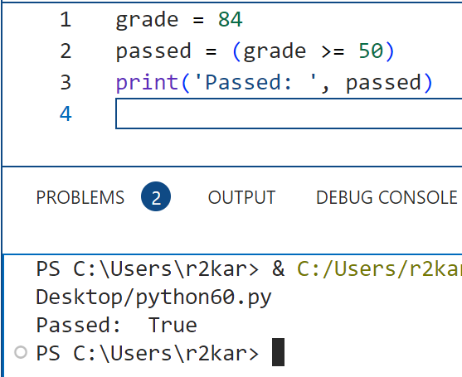
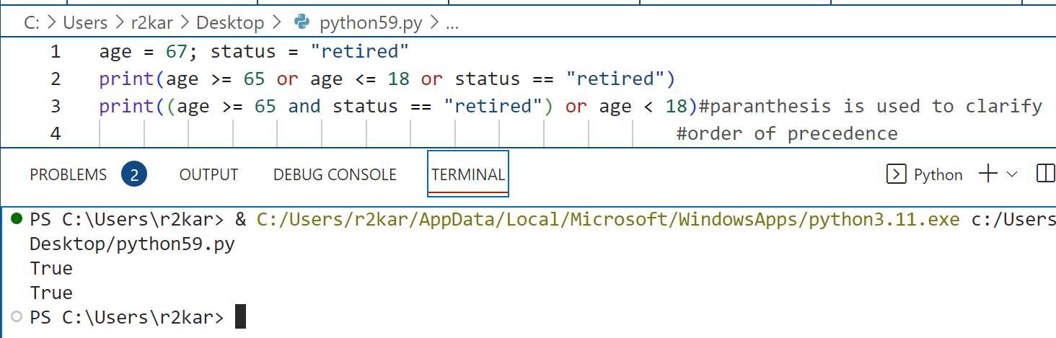
Python Fundamentals(2)
Working with relational and logical operators: (examples)

Slide 50
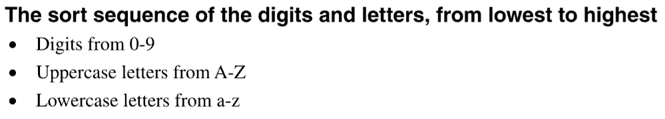
Python Fundamentals(2)
Working with relational and logical operators: comparing strings
When numbers are compared, they are compared based on their numeric values. By contrast, the comparison of strings is more complicated. They are evaluated on a character by character basis from left to right. Thus, “peach” comes before “pear”.
To understand string comparisons, though, you need to know the sort sequence of the letters and digits.
The digits are lower than (come before) all uppercase letters, and uppercase letters are lower than (come before) all lowercase letters. But that means that “Peach” comes before “apple”, which isn’t usually what you want when you sort or compare two strings.

Slide 51
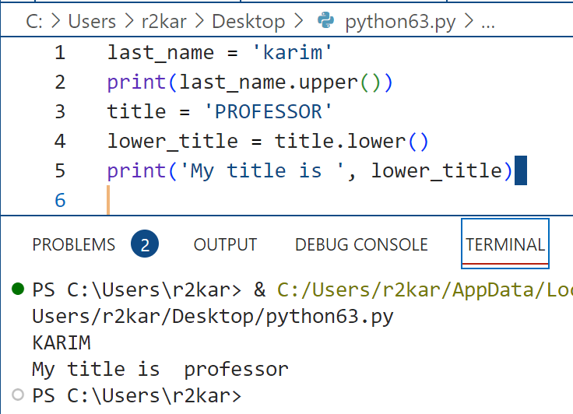

Python Fundamentals(2)
Working with relational and logical operators: comparing strings
To resolve this issue of strings comparison, Python provides two string methods. The lower() method converts a string to all lowercase letters. The upper() method converts a string to all uppercase letters.
You call the method with the dot ( . ) notation, starting with a string then dot following by one of these methods:
my_str = ‘karim’
my_str.upper()
By converting both operands to the same case (lower or upper) you can make the comparisons without getting unexpected results.

Slide 52
Python Fundamentals(2)
Pseudocode for writing selection (Decision) structures
To resolve this issue of strings comparison, Python provides two string methods. The lower() method converts a string to all lowercase letters. The upper() method converts a string to all uppercase letters.

Slide 53
Python Fundamentals(2)
Working with string data: Do it yourself!
Problem 1
How would you compare the followings: (YES, yes), and (NO, no)? Hint: what methods would you use?
Then use one of these methods to compare them with a user input and display the result (True or False).
Then use a logical operator to combine both terms in one Boolean expression to compare and display the result.
Problem 2
Suppose that we have three variables (day, ticketPrice and status) – the day can be either weekday or weekend; the status can be one of the following: a student, a child less than 14 years old, or an elder greater than 65 years old.
Use logical operators to test the three variable all in one line by joining them in a compound conditional expression. Then display the result (True or False)

Slide 54
References
Material has been taken from (can be accessed through Sheridan's Library Services) :
Starting Out with Python (ISBN-13: 9780136912330 ):
https://www.pearson.com/en-ca/subject-catalog/p/starting-out-with-python/P200000003356/9780136912330
Murach’s Python 2nd Edition programming, 2nd Edition :
https://bookshelf.vitalsource.com/reader/books/9781943872756/pages/recent
Introducing Python, Lubanovic, B., O'Reily Media, 2nd Edition, 2019
https://www.oreilly.com/library/view/introducing-python-2nd/9781492051374/

